Slide 1
The state of segregation:
70 years after Brown
Ann Owens, University of Southern California
Sean Reardon, Stanford University
May 6, 2024

Slide 2
10 Insights into School Segregation
Measuring school segregation
How did Brown v. Board of Education change school segregation?
How has racial/ethnic school segregation changed recently?
Has school segregation returned to pre-Brown levels?
How has economic school segregation changed recently?
What role do school district boundaries play in school segregation?
Where is segregation high?
How do non-school factors shape recent trends in school segregation?
How do educational policies shape recent trends in school segregation?
How does school segregation affect educational opportunities?

Slide 3
1. Measuring school segregation
The normalized exposure index compares the compositions of schools attended by students of different racial/ethnic or economic groups.
  Also known as the variance ratio index, the relative variation index, or eta².
Highly correlated with other standard measures of segregation (dissimilarity index, information theory index)
  but readily interpretable and has better mathematical properties

Slide 4
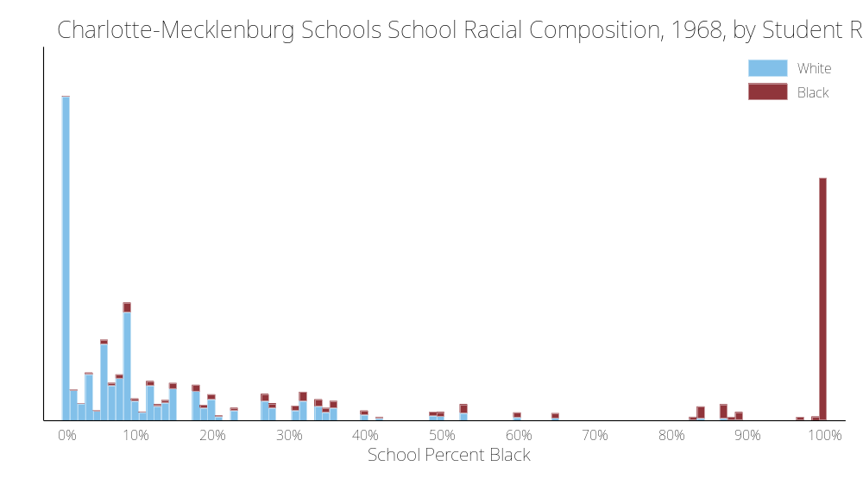

Slide 5
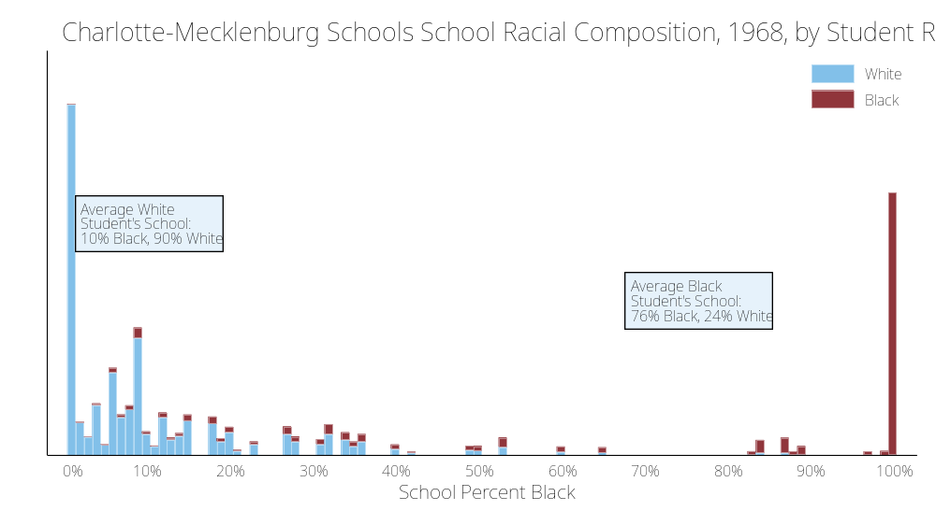

Slide 6
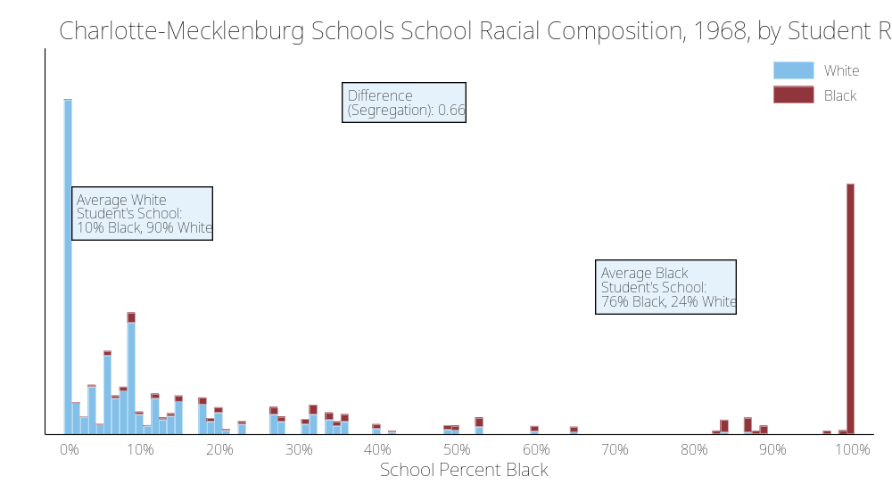

Slide 7
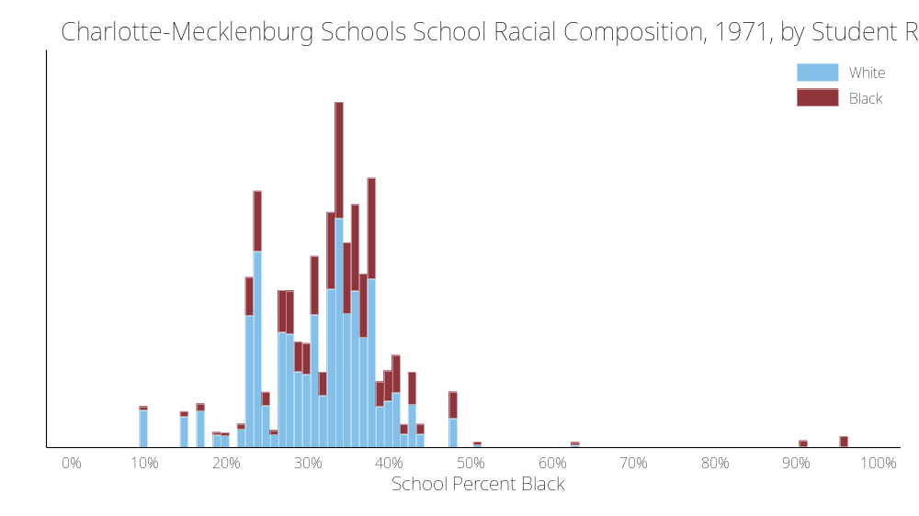

Slide 8
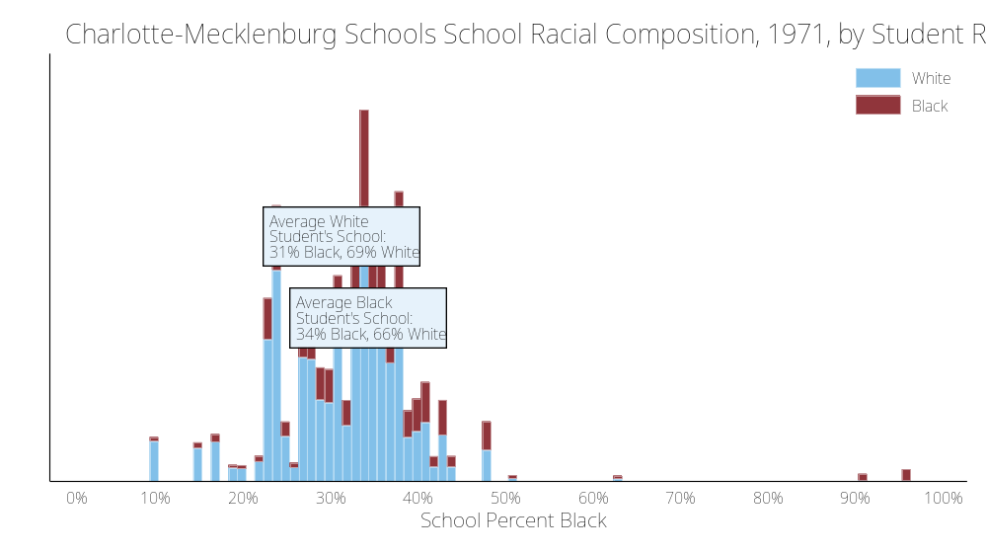

Slide 9
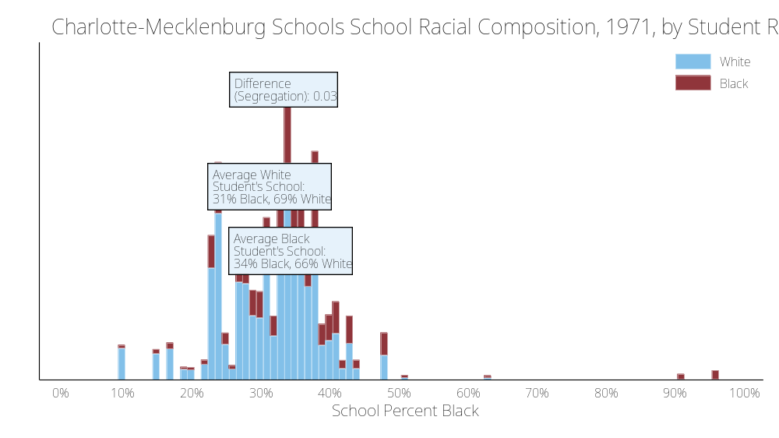

Slide 10
2. How did Brown v. Board of Education change school segregation?
Brown v. Board declared separate schooling systems unequal and unconstitutional. It paved the way for future decisions that led to affirmative desegregation of schools within districts.
However, school segregation in the South did not change much in many places until the 1968 Green v New Kent County decision.

Slide 11
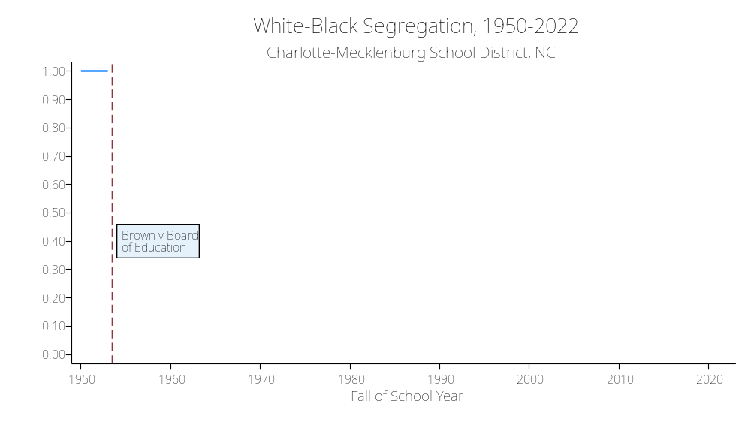

Slide 12
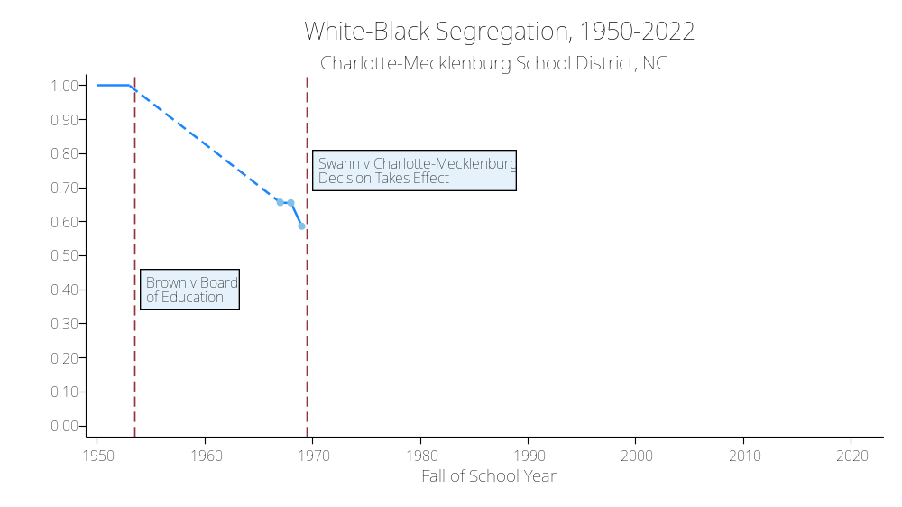

Slide 13
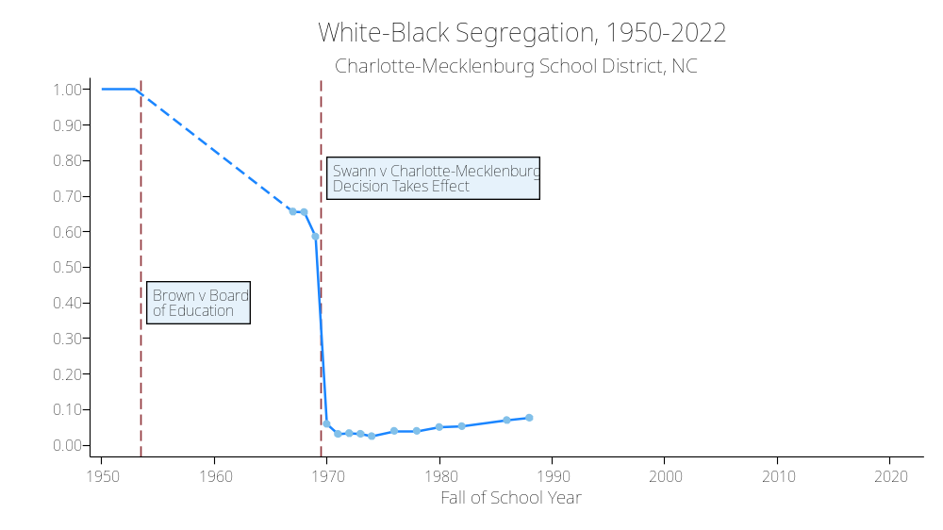

Slide 14
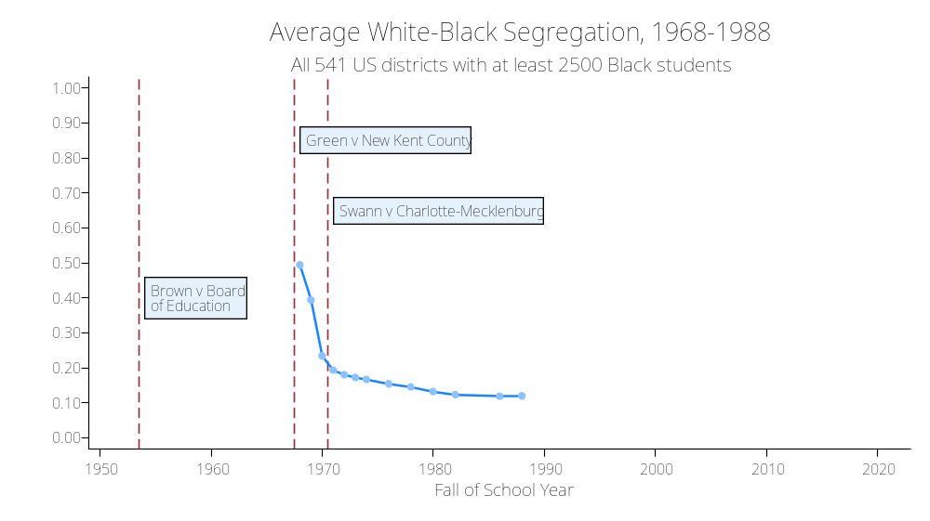

Slide 15
3. How has racial/ethnic school segregation changed recently?
School segregation has increased by 37% since 1991 in large districts.
The increase is large in relative terms but modest compared to the declines in segregation prior to 1973
Segregation is very high in some large districts

Slide 17
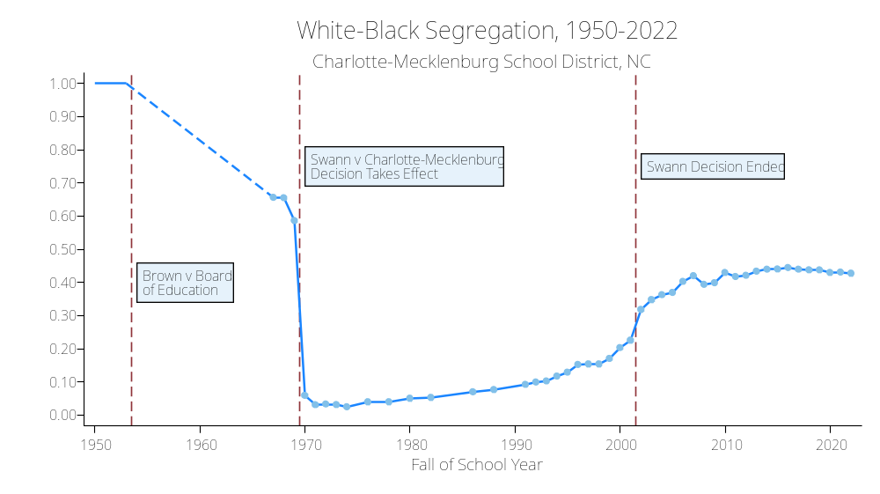

Slide 18
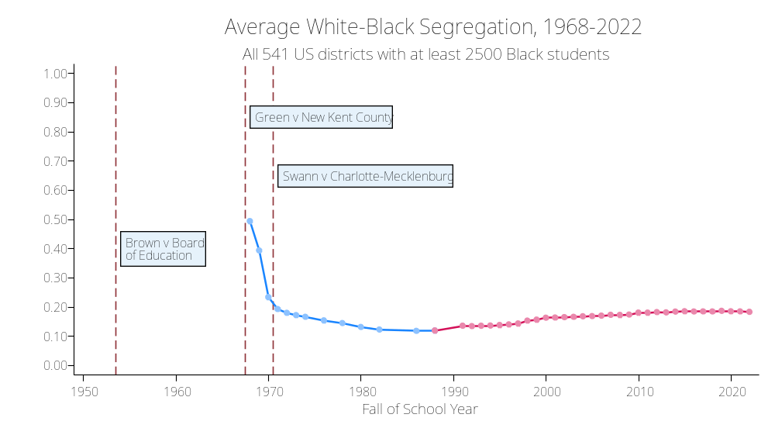

Slide 20
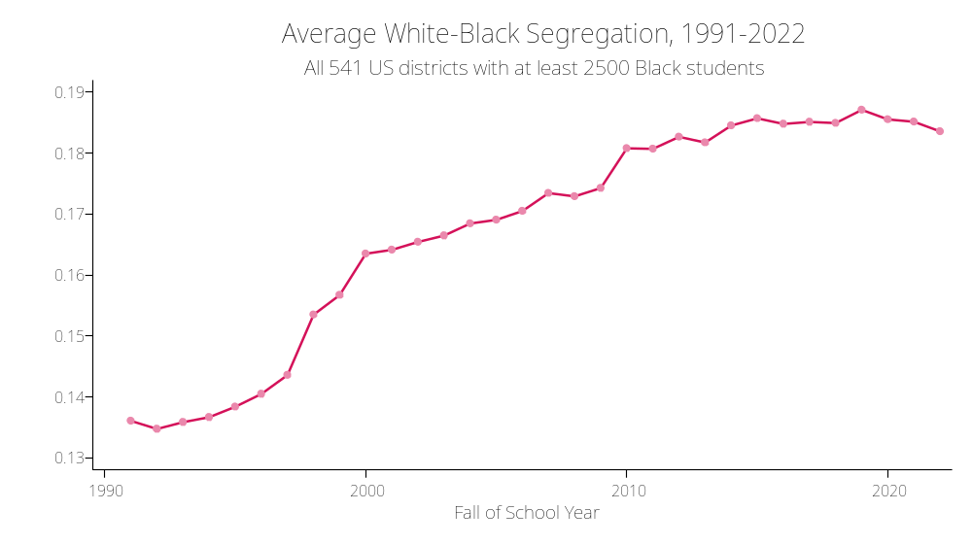
White-Black segregation grew by 37% from 1991-2019

Slide 21
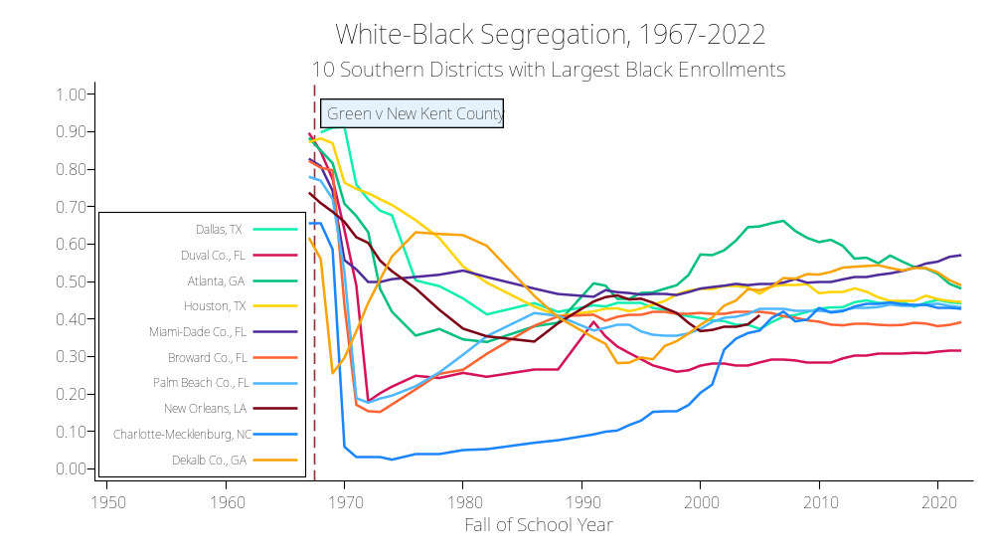

Slide 22
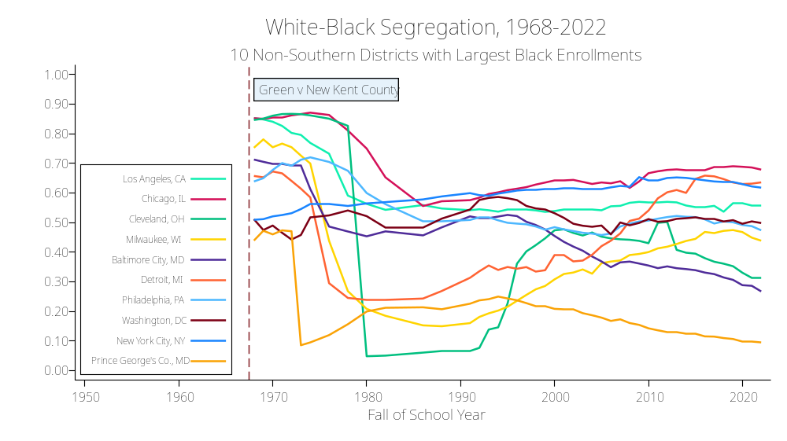

Slide 23
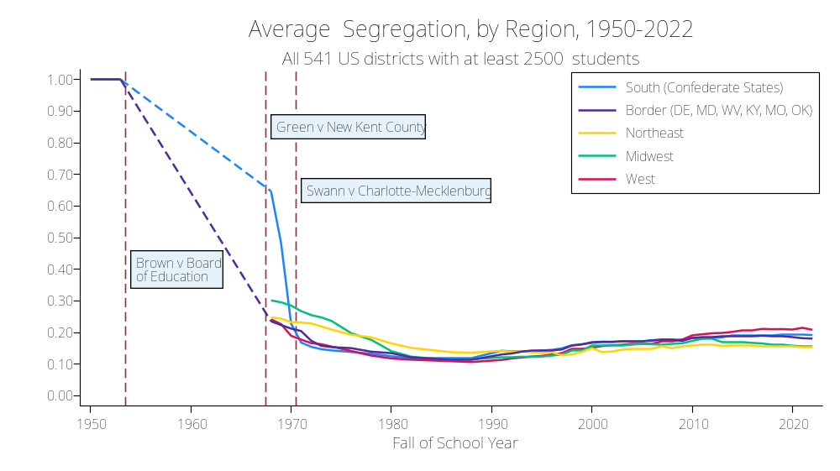

Slide 24
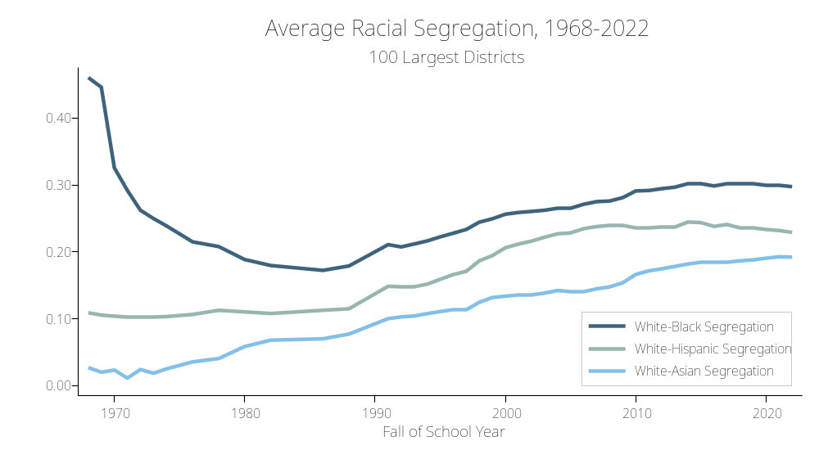

Slide 25
4. Has school segregation returned to pre-Brown levels?
No. Segregation levels are high, troubling, and rising in large districts, but they are not at pre-Brown levels.
Some scholars have noted that the proportion of students in predominantly minority (Black/Hispanic/Native) schools has risen sharply and is higher than it was in the late 1960s.
But this is mostly (but not entirely) due to changing student demographics.
As the school population has become less White, all students attend school with fewer White students than in the past.

Slide 26
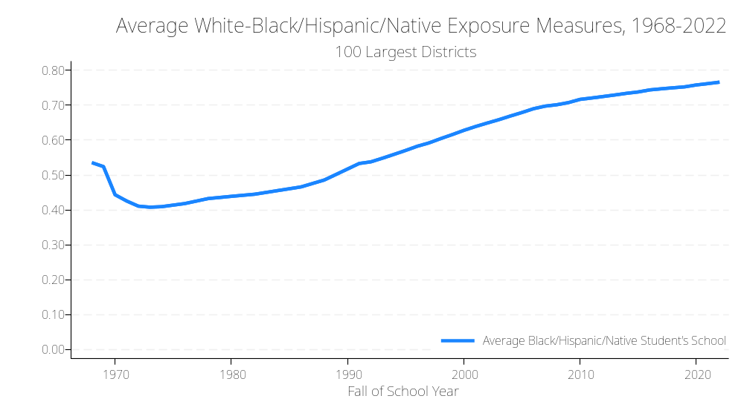

Slide 27
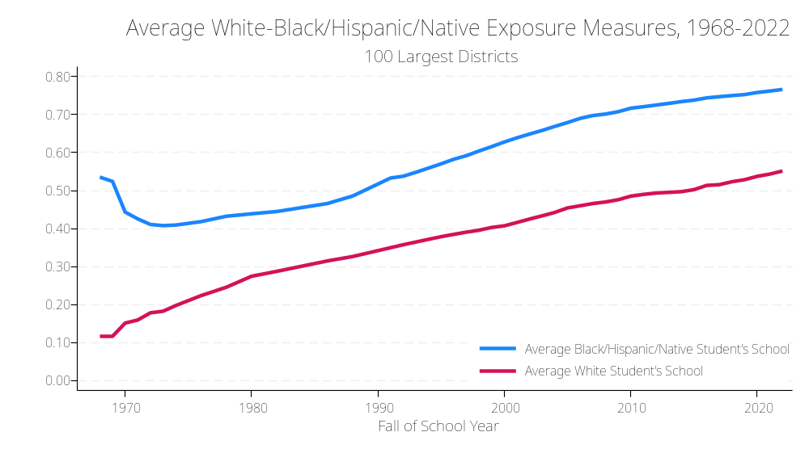

Slide 28
5. How has economic school segregation changed since 1991?
Segregation between students eligible and ineligible for free lunch has increased in large districts since 1991.
  Most of that increase is in the last 15 years.
Racial-economic segregation—the racial/ethnic difference in exposure to school poverty—has also increased.
We don’t have data prior to 1991 on economic segregation.

Slide 29
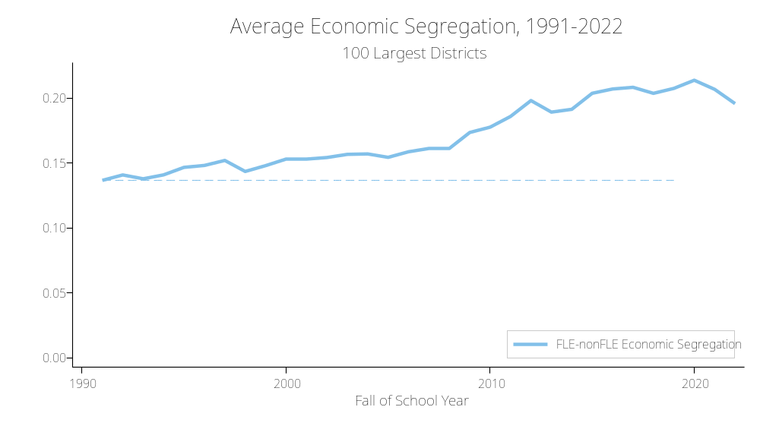
Economic school segregation grew by 52% from 1991-2019

Slide 30
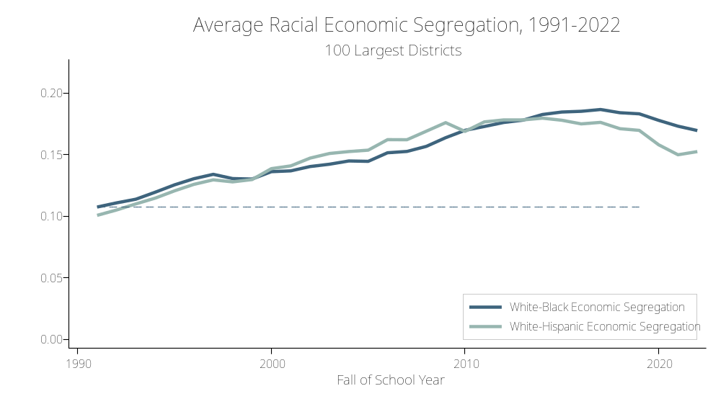
Black-White economic school segregation grew by 70% from 1991-2019

Slide 31

Hispanic-White economic school segregation grew by 68% from 1991-2019

Slide 32
6. What role do school district boundaries play in school segregation?
The analyses above focus on segregation among schools in the same district.
But most school segregation in metropolitan areas occurs between districts, rather than between schools within the same district.

Slide 33
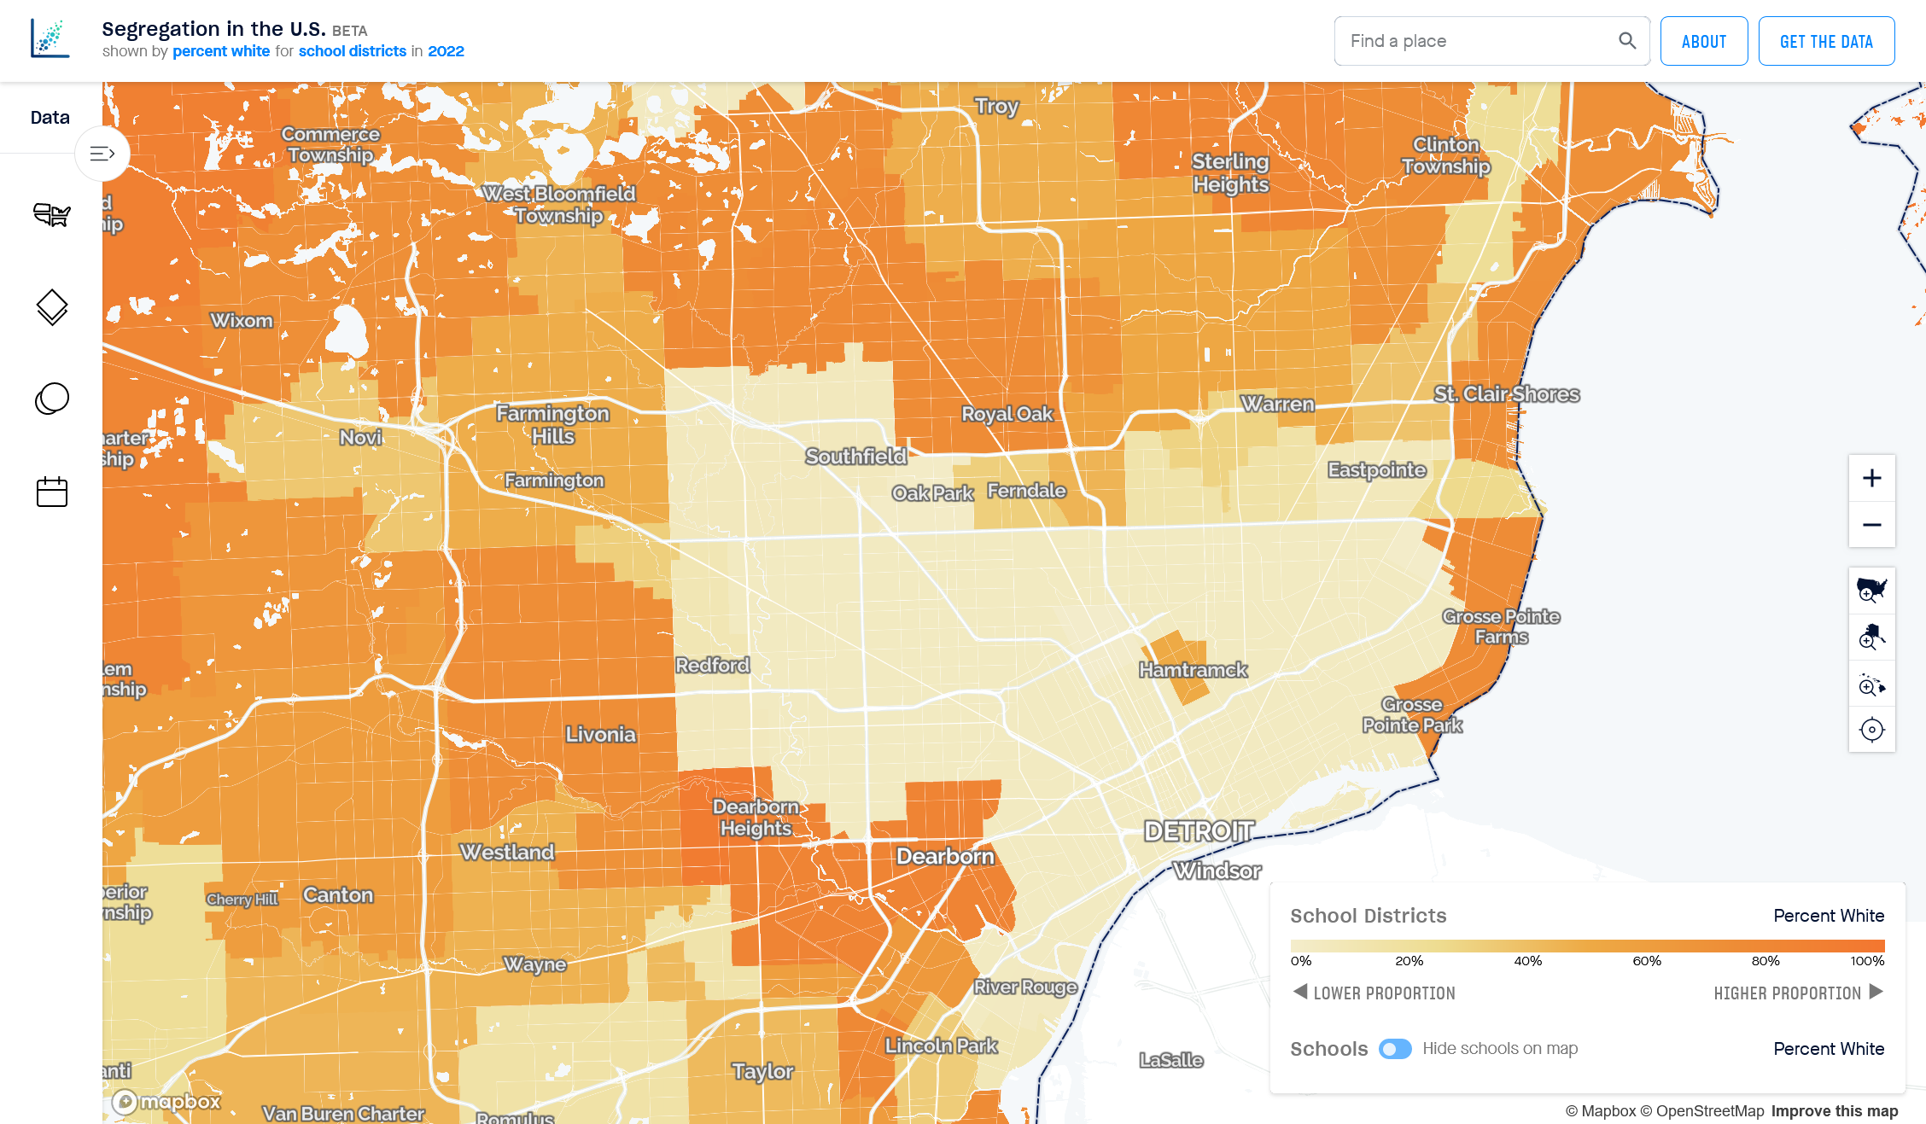

Slide 34


Slide 35
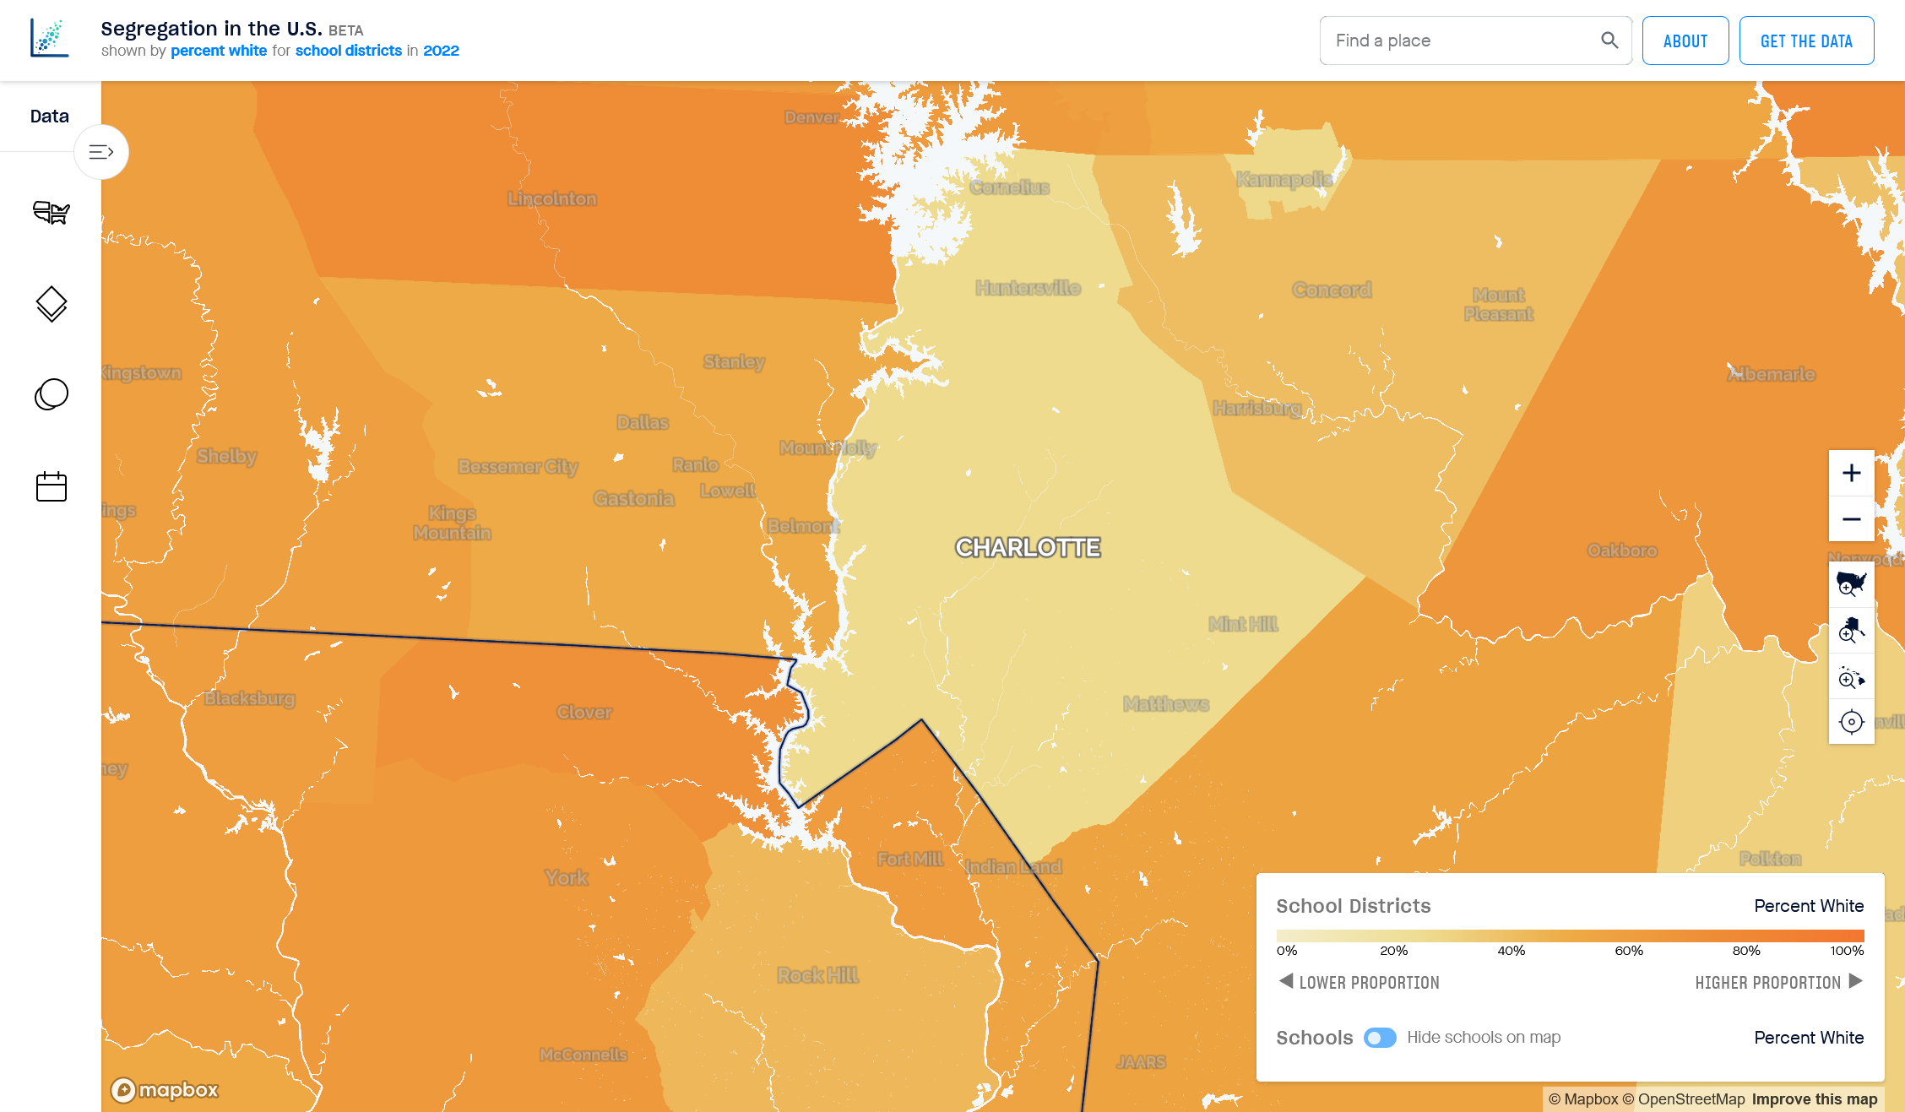

Slide 36
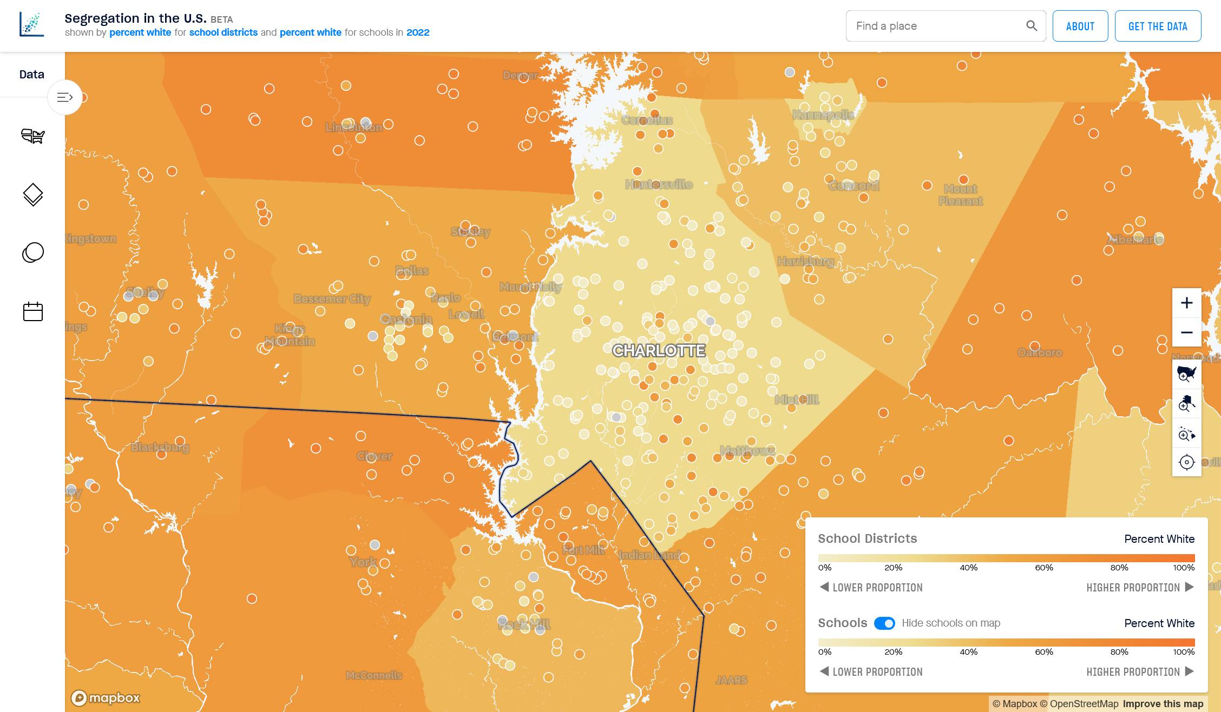

Slide 37
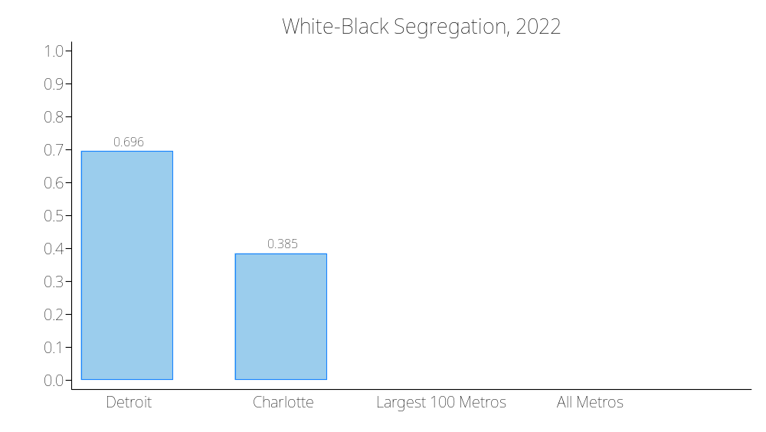

Slide 38
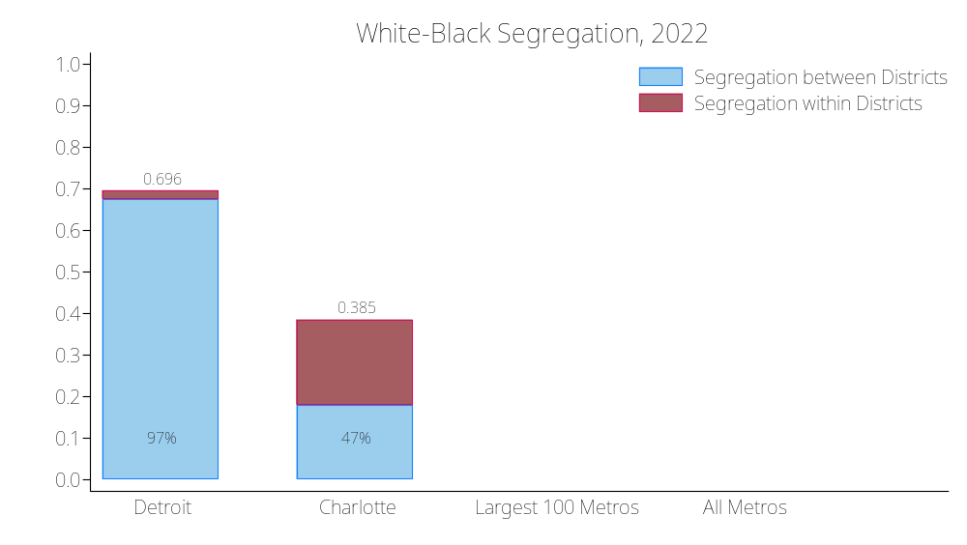
In the Detroit metropolitan area, between-district segregation is very high, and accounts for 97% of total metropolitan area segregation
In the Charlotte metropolitan area, between-district segregation is much lower, and accounts for 47% of total metropolitan area segregation

Slide 39
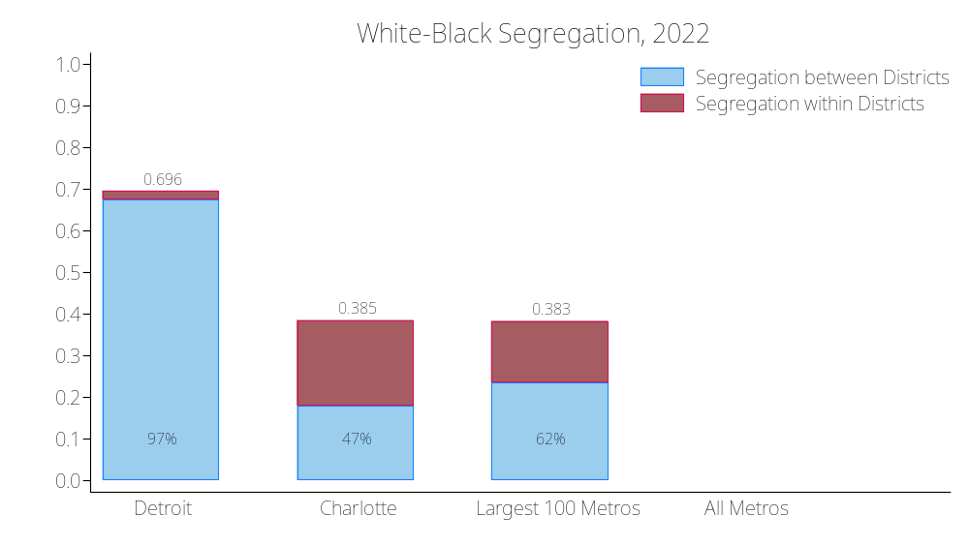

Slide 40
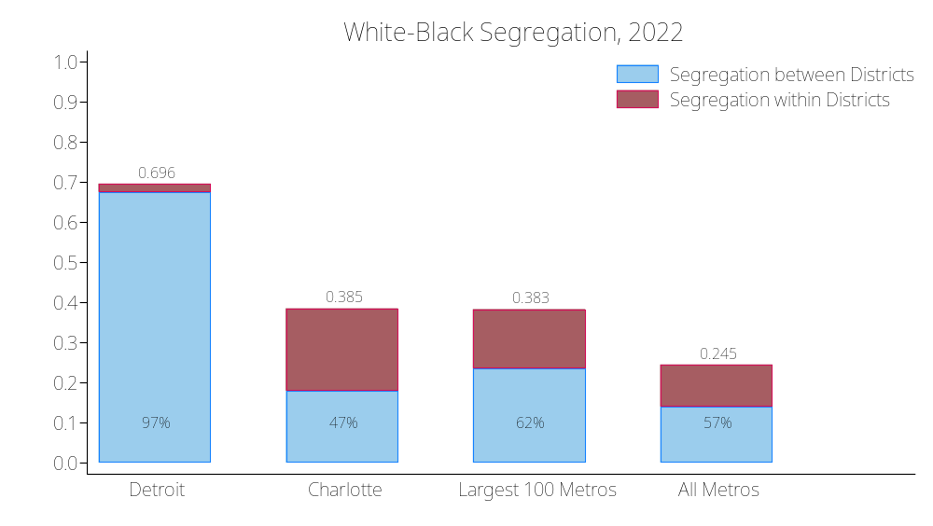
On average, between-district segregation accounts for about 60% of total metropolitan area segregation

Slide 41
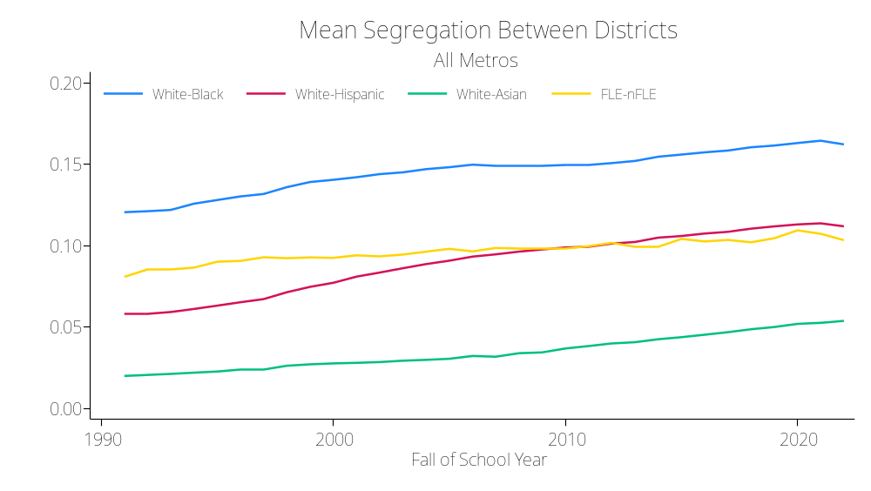
Between-district segregation has been increasing since 1991

Slide 42
7. Where is segregation high?
Generally, school segregation is higher in places with:
  higher residential segregation
  higher racial/ethnic socioeconomic inequality
  larger enrollments and more schools

Slide 43
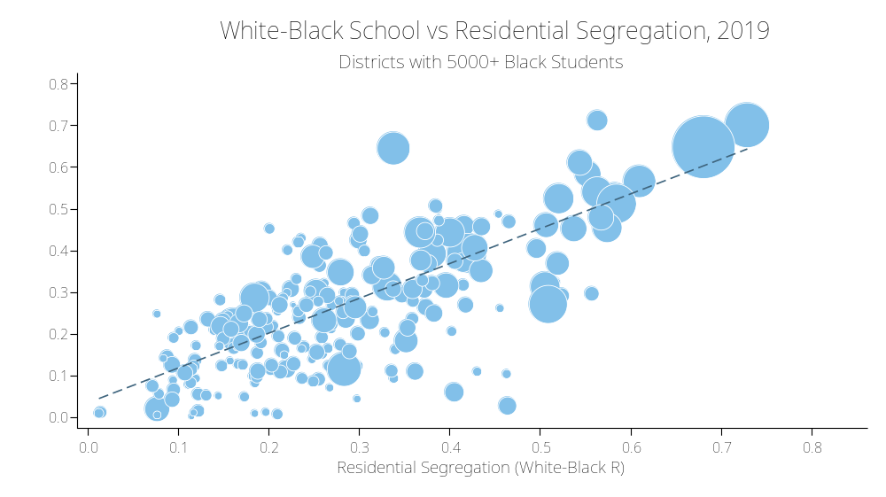

Slide 44
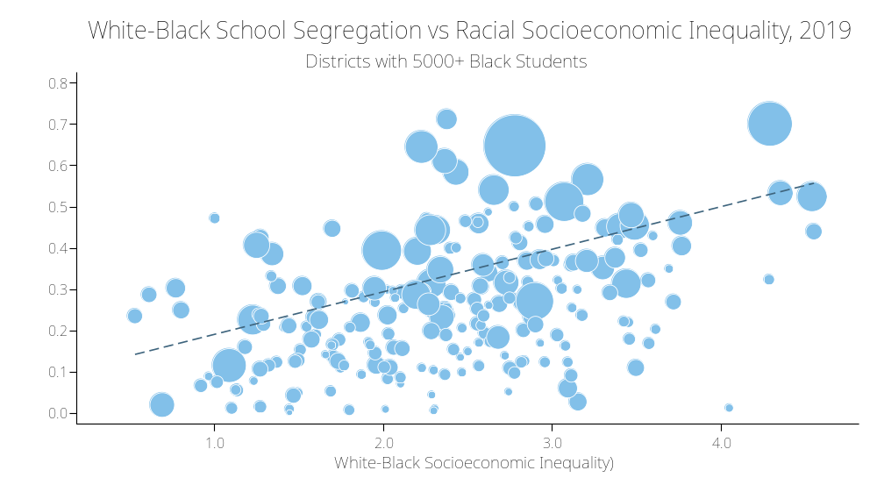

Slide 45
8. How do non-school factors shape recent trends in school segregation?
Although segregation is higher in more segregation and economically unequal places, both residential segregation and racial socioeconomic inequality have been declining in large districts over the last 30 years.
In most districts, school segregation has increased while residential segregation and inequality have declined.
The rise in school segregation is not due to changes in racial/ethnic residential segregation and racial/ethnic socioeconomic inequality.

Slide 46
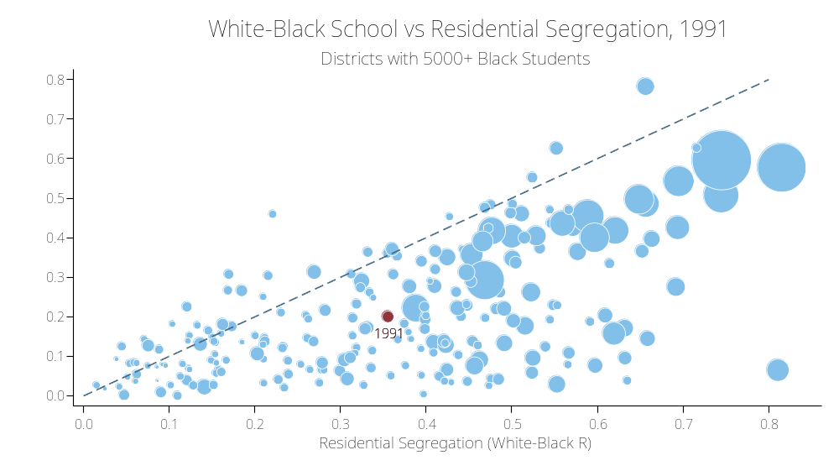

Slide 47
In 1991, schools were much more integrated than neighborhoods:
the average black-white neighborhood segregation was 0.36;
the average school segregation was 0.20.

Slide 48
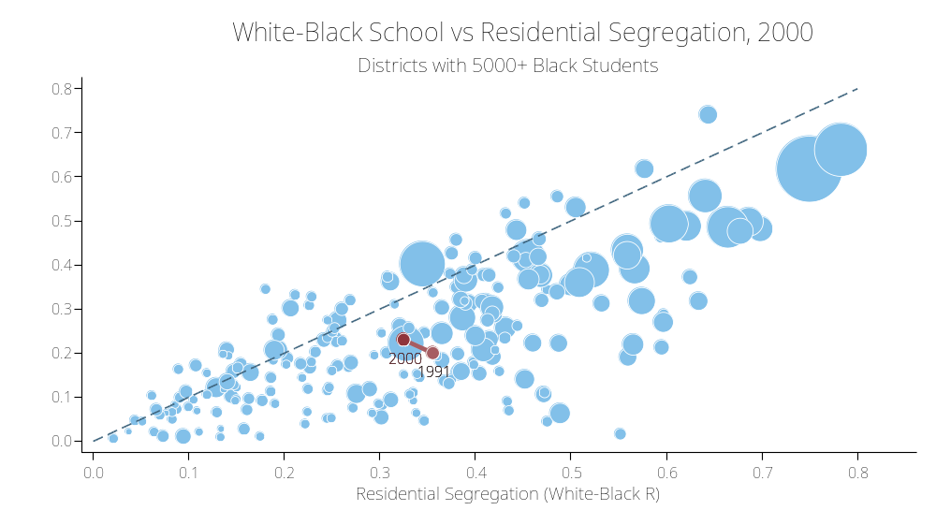
In 1991, schools were much more integrated than neighborhoods:
the average black-white neighborhood segregation was 0.36;
the average school segregation was 0.20.

Slide 49
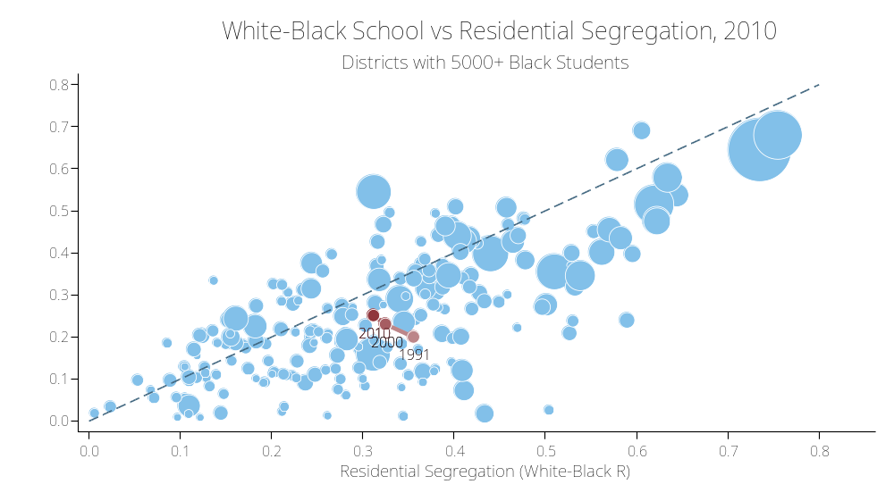
In 1991, schools were much more integrated than neighborhoods:
the average black-white neighborhood segregation was 0.36;
the average school segregation was 0.20.

Slide 50
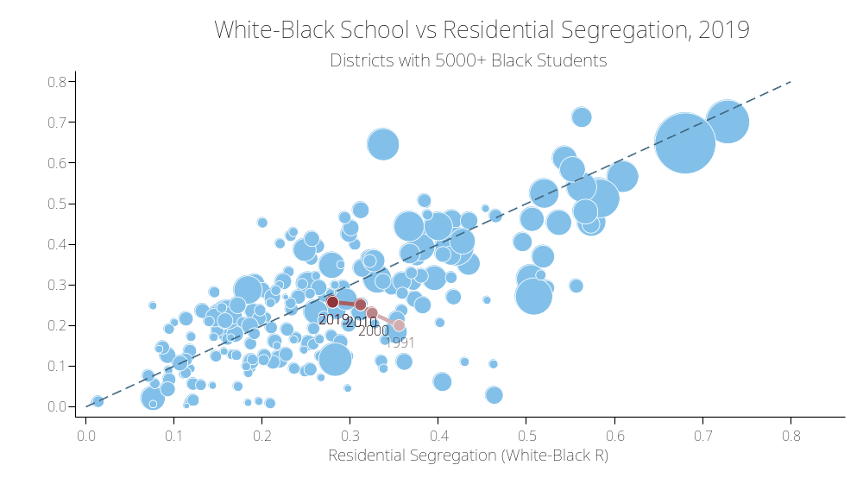
By 2019, average neighborhood segregation had declined to 0.28; while school segregation grew to 0.26.
Schools increasingly mirror their neighborhoods
In 1991, schools were much more integrated than neighborhoods:
the average black-white neighborhood segregation was 0.36;
the average school segregation was 0.20.

Slide 51
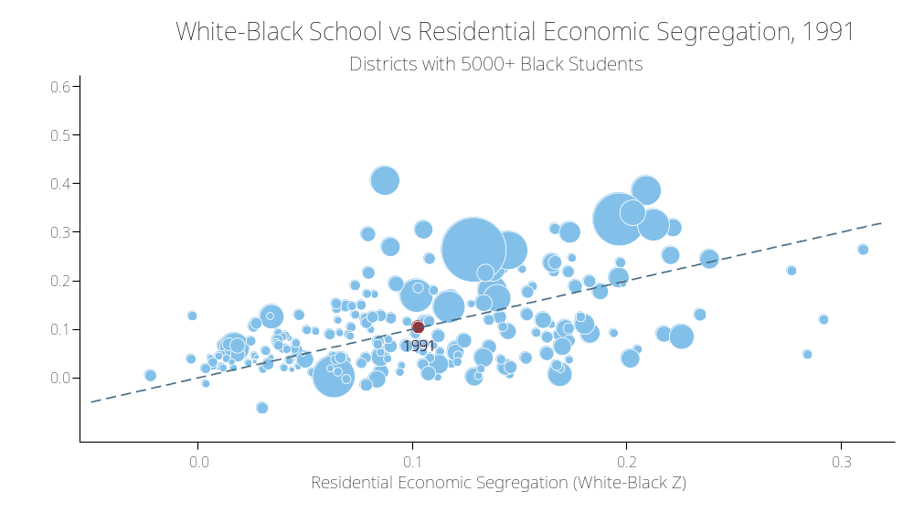

Slide 52
In 1991, the black-white difference in both neighborhood and school poverty was 10 percentage points.

Slide 53
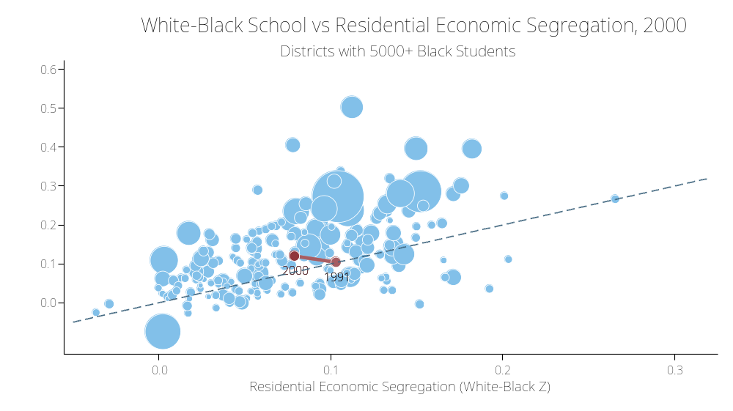
In 1991, the black-white difference in both neighborhood and school poverty was 10 percentage points.

Slide 54
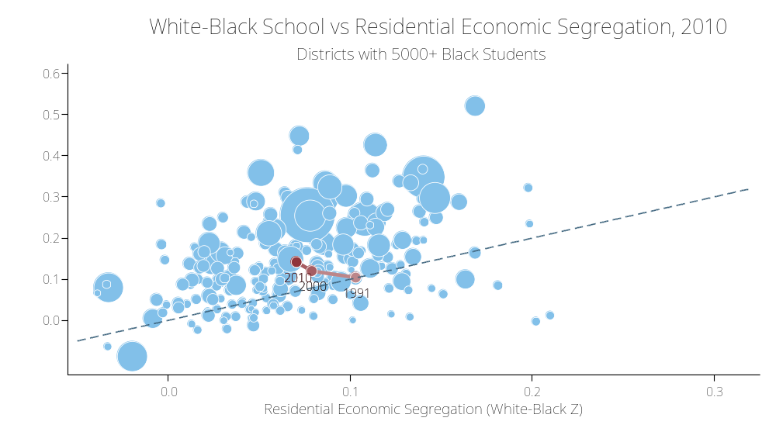
In 1991, the black-white difference in both neighborhood and school poverty was 10 percentage points.

Slide 55
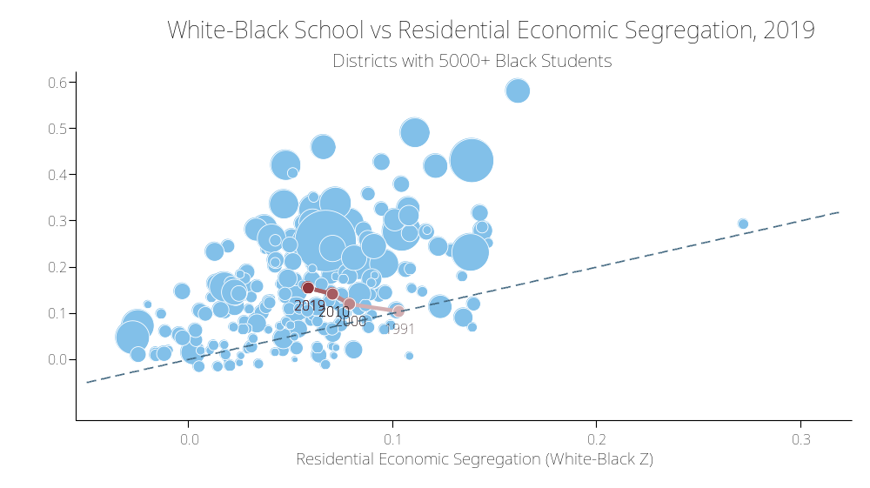
In 2019, the black-white difference in neighborhood poverty was only 6 percentage points;
the black-white difference in school poverty was 15 percentage points
In 1991, the black-white difference in both neighborhood and school poverty was 10 percentage points.

Slide 56
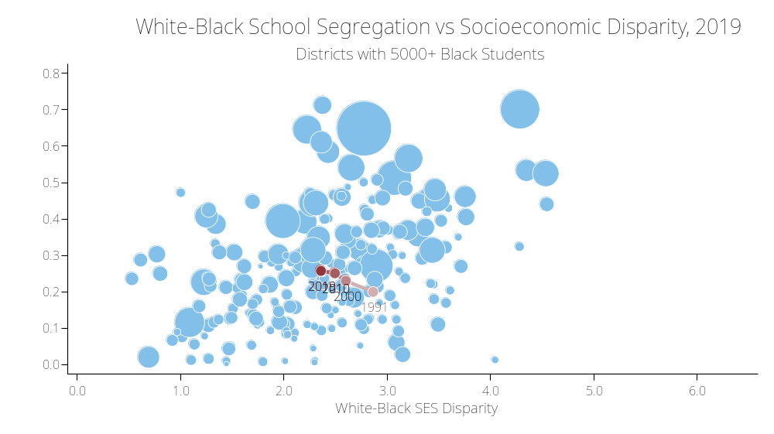
From 1991-2019, the average racial socioeconomic disparity in these districts declined by 20%.
From 1991-2019, the average racial segregation level in these districts increased by 29%.

Slide 57
9. How does educational policy shape recent trends in school segregation?
We examine the role of 2 factors:
  The end of court-ordered desegregation in many districts
  The expansion of school choice (proxied by the expansion of the charter school sector)
Since 1991, roughly two-thirds of districts that were under court-ordered desegregation have been released from Court oversight.
Since 1998, the charter sector has grown, though the rate of expansion varies widely among districts.

Slide 58
9. Estimating counterfactual trends in school segregation
We fit 2-way fixed effects models to estimate the associations between school segregation levels and changes in residential segregation, racial income differences, court order status, and the expansion of the charter sector.
  Rich set of time-varying district control variables
We use the estimated parameters from these models to construct counterfactual trends in segregation levels – estimates of what the trends would have been had each of these factors been unchanged since 1991.

Slide 59
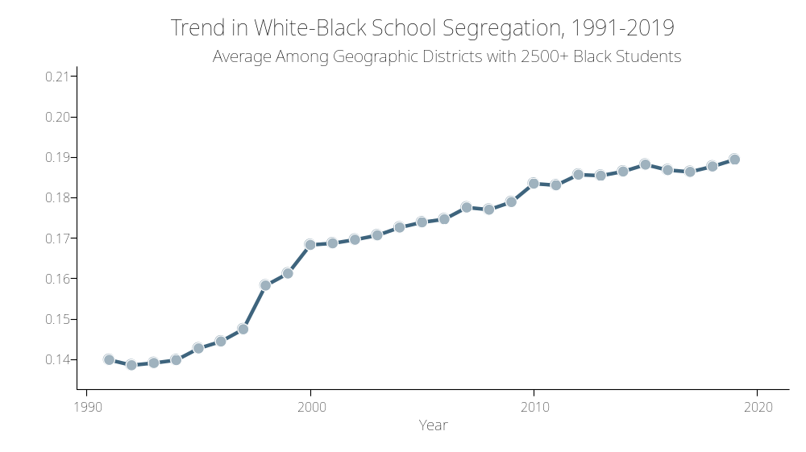
School segregation grew by 35% in large districts from 1991-2019

Slide 60
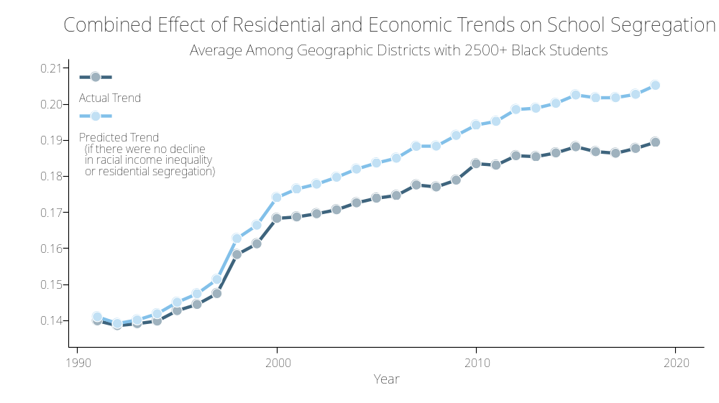
However, school segregation would have grown by 30% more were it not for declining residential segregation and racial economic inequality.

Slide 61
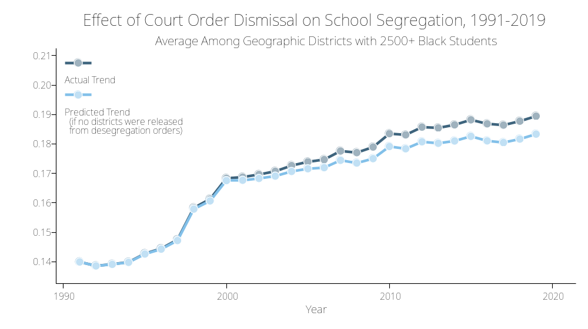
School segregation would have grown by 12% less were it not for the fact that many districts were released from court ordered desegregation plans.

Slide 62
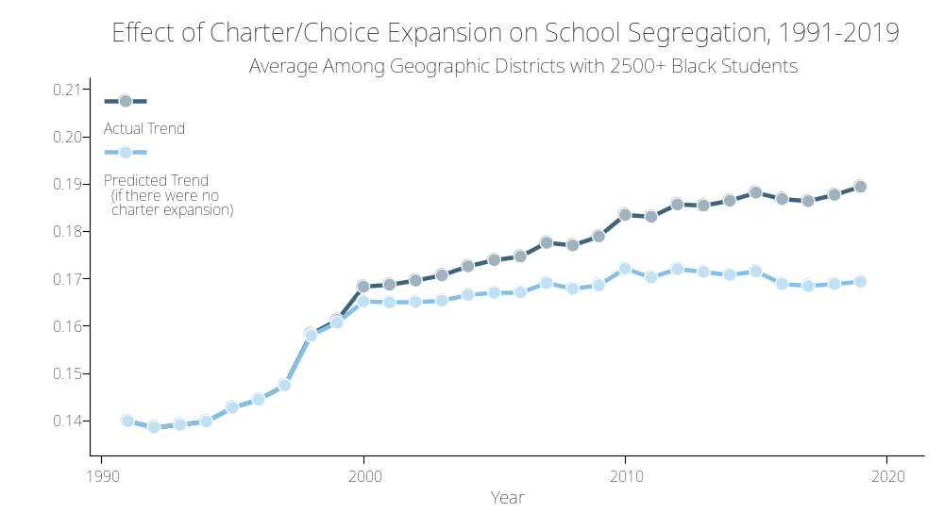
School segregation would have grown by 40% less from 1991-2019 were it not for the expansion of charter schools.

Slide 63
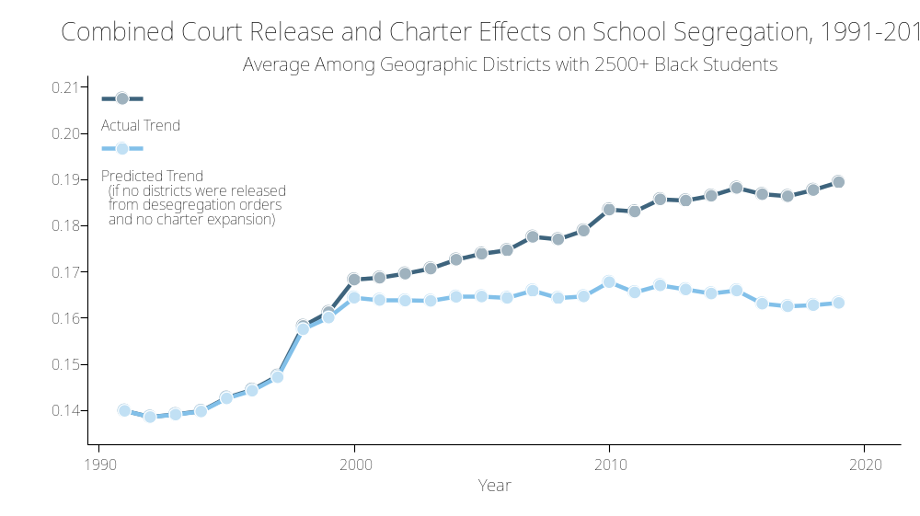
All of the growth in school segregation since 2000 is attributable to changes in student assignment and school choice/charter expansion.

Slide 64
10. How does school segregation affect educational opportunities?
School segregation is strongly associated with racial/ethnic achievement gaps.
More importantly, school segregation is strong associated with the rate at which achievement gaps widen during school – segregation appears to lead to unequal learning opportunities for students of different groups.
Segregation appears to shape educational outcomes because it concentrates Black and Hispanic students in much higher poverty schools than their White peers.

Slide 65
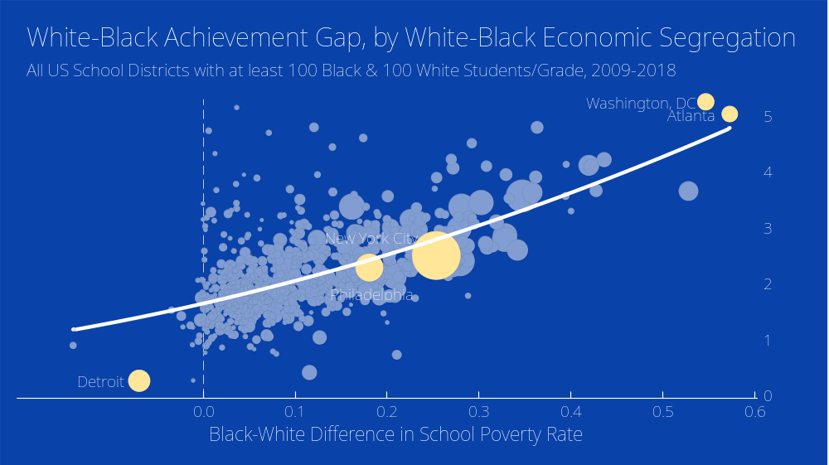

Slide 66
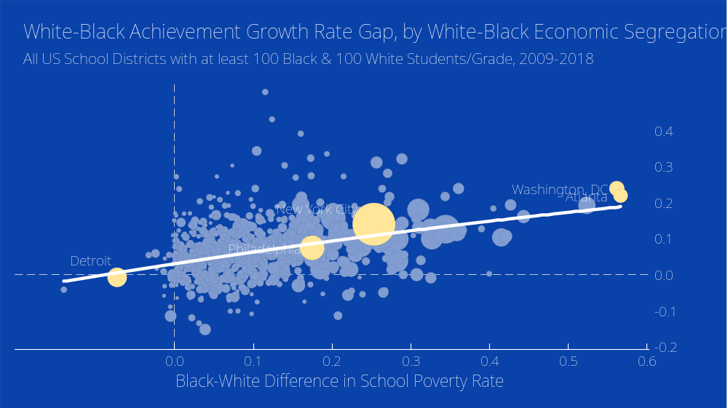

Slide 67
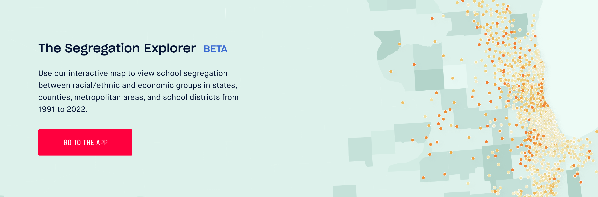
The Segregation Explorer
http://edopportunity.org/segregation

Slide 68
